Slide 1


Kanji かんじ 漢 字
Jiajun Bracewell

Slide 2
objectives
1. Four types of kanji based on their formation.
2. Kanji movie
3. Kanji list
4. Kanji tracing practice
5. Kanji Stroke Order and Examples
6. Table of Japanese kanji radicals in wikipedia
7. Character structures
8. Different fonts
9. Different effects
10. You just wonder how to write some kanji
11. How to look up a kanji if you do not know the pronunciation
12. Kanji Look and Learn

Slide 3
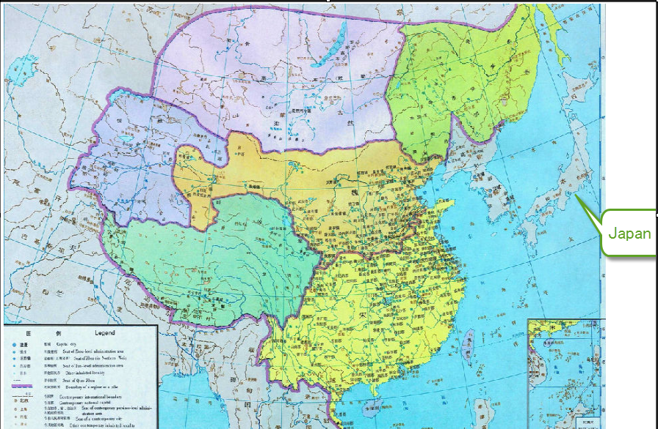
Kanji
Kanji are Chinese characters
introduced to Japan more than 1500 years ago
Hiragana and katakana evolved later in Japan based on the simplified Chinese characters
1500 years ago, China and Japan

Slide 4
Kanji
Kanji represents both meanings and sounds.
Most kanji possess multiple readings,
On-yomi (Chinese readings)
derived from the pronunciations used in China
Some kanji have more than one on-yomi due to temporal and regional variances in the Chinese pronunciation
kun-yomi (Japanese readings)
When people started to use kanji to write native Japanese words, Japanese readings (kun-yomi) were added to kanji

Slide 5
kanji
high school: are expected to know 2136 kanji (called joyo kanji)
elementary school: 1006 kanji are taught

Slide 6
1. Four types of kanji
(1) Pictograms
(2) Simple ideograms
(3) Compound ideograms
(4) Phonetic-ideographic characters

Slide 7
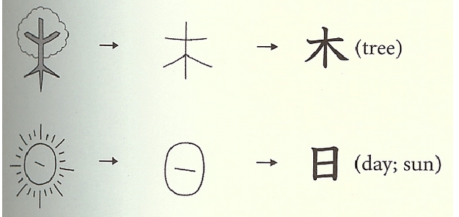
1. Four types of kanji (1) Pictograms
made from pictures

Slide 8
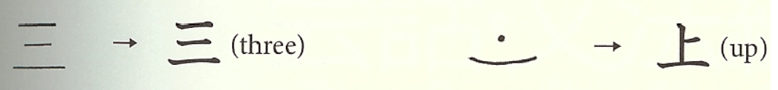
1. Four types of kanji (2) Simple ideograms
made of dots and lines to represent numbers or abstract concepts.

Slide 9
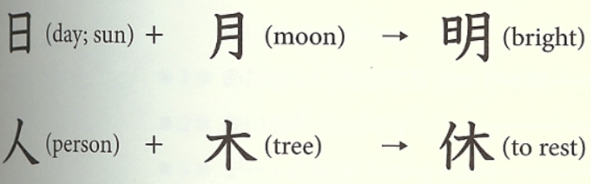
1. Four types of kanji (3) Compound ideograms
made from the combination of two or more kanji

Slide 10
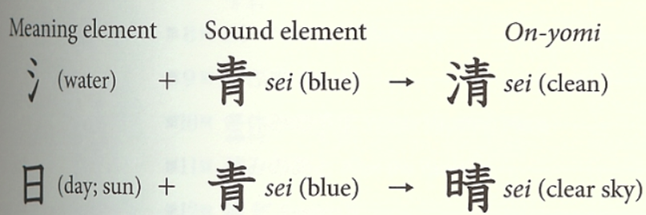
1. Four types of kanji (4) Phonetic-ideographic characters
made up of a meaning element and a sound element.
90% are Phonetic-ideographic characters

Slide 11
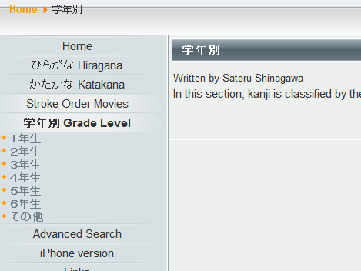
2. Kanji movie
http://marinebat.com/gahoh/index.php?option=com_content&task=view&id=35&Itemid=50

Slide 12
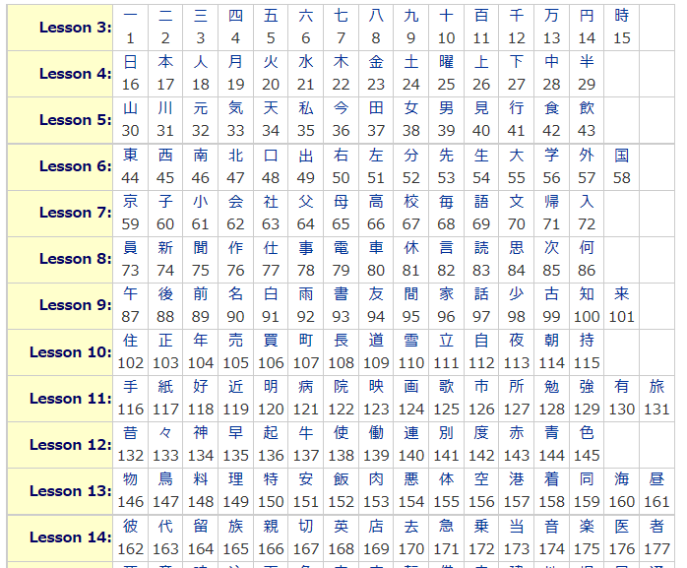
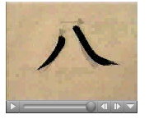
3. Kanji list
Handwriting of Genki Kanji List

Slide 13
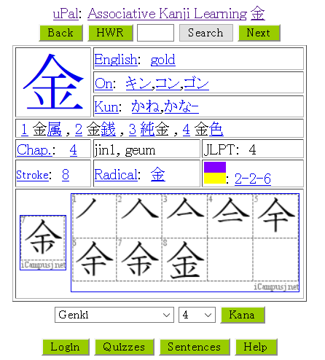
4. Kanji tracing practice
Kanji tracing practice

Slide 14
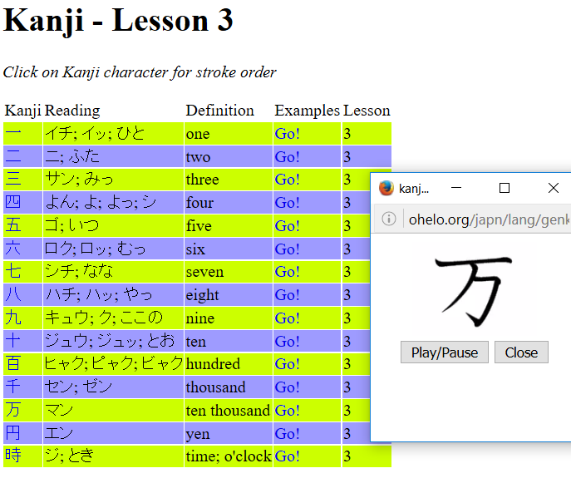
5. Kanji Stroke Order and Examples
Kanji Stroke Order and Examples

Slide 15
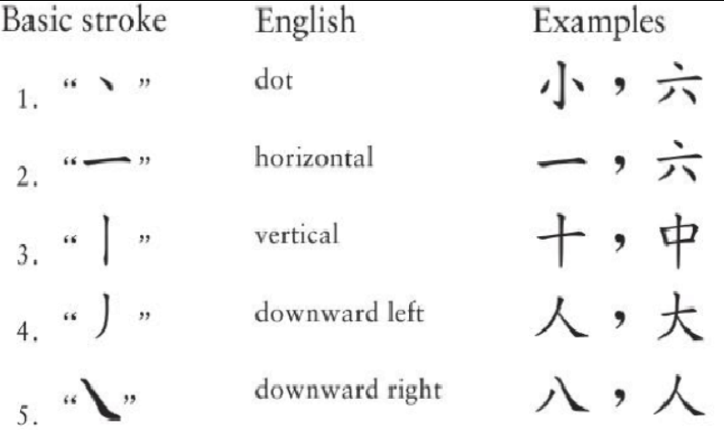
5. Kanji Stroke Order and Examples
a. basic strokes

Slide 16
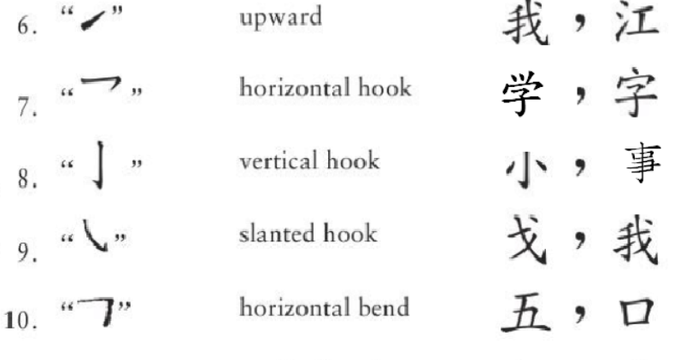
5. Kanji Stroke Order and Examples
a. basic strokes

Slide 17
5. Kanji Stroke Order and Examples
b. basic stroke order
1. From left to right. 川、人
2. From top to bottom. 三
3. Horizontal befor vertical. 十
4. From outside to inside. 月
5. Middle before two sides. 小
6. Inside before closing. 日、回

Slide 18
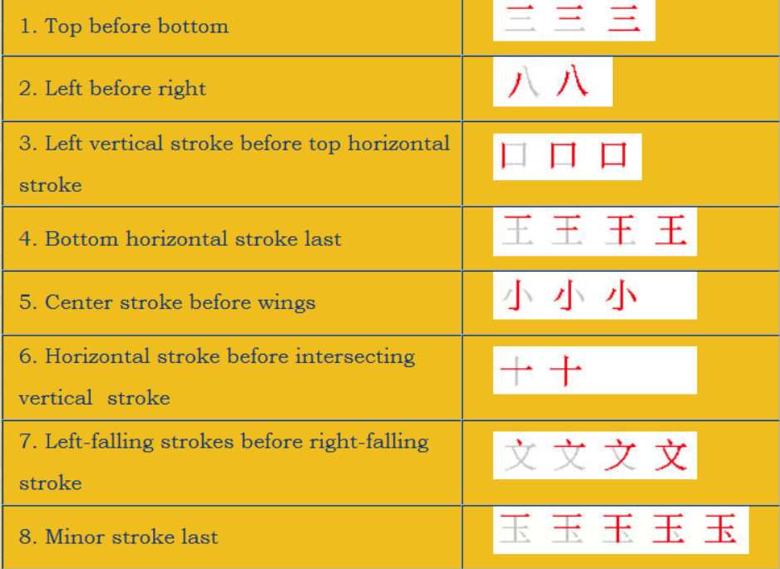
5. Kanji Stroke Order and Examples b. basic stroke order
From Chinese Calligraphy Video Tutorial

Slide 19
6. Table of Japanese kanji radicals in wikipedia
Table of Japanese kanji radicals
a. The six radicals that occur the most frequently (in order of frequency) and make up 25% of the 2136 Jōyō kanji:
口 (くち) mouth
水/氵 (みず) water
木 (き) tree
人/亻 (ひと) person
手/扌 (て) hand
心/忄/⺗ (こころ) heart

Slide 20
6. Table of Japanese kanji radicals in wikipedia
b. Twelve radicals that together with the above make up 50% of Jōyō kanji:
言 (こと) word
日 (ひ/にち) sun/day
糸・幺 (いと) thread
肉･月 (にく・つき) meat/organ (moon)
土 (つち) ground
⻌ go/road radical
艹 grass/plant radical
宀 roof/crown radical
貝 (かい) shell
女 (おんな) woman
阝 village (right) wall (left) radical
金 (きん) gold/metal

Slide 21
6. Table of Japanese kanji radicals in wikipedia
c. Thirty radicals that together with the above make up 75% of Jōyō kanji:
一 (いち) one
刀/刂 (かたな) sword
十 (じゅう) ten
田 (た) rice field
火/灬 (ひ/か) fire
大 (おお) big
山 (やま) mountain
食 / 飠 (しょく) eat, food
車 (くるま) vehicle
彳 walking person radical
目 (め) eye
雨 (あめ) rain
犬 / 犭 (いぬ) dog
玉（王） (たま・おう) king / ball (jewel)
玉（王） (たま・おう) king / ball (jewel)
石 (いし) stone
力 (ちから) power
衣/衤 (ころも) garment
弓 (ゆみ) bow
竹・⺮ (たけ) bamboo
又 (また) again
攵/夂 action radical
示/礻 (しめす) show on an altar radical
酉 (とり) alcohol radical
囗 (くにがまえ) enclosure radical
禾 grain radical
广 building on a cliff radical
疒 sickness radical
巾 (きん/はば) cloth radical
尸 (し) corpse radical
寸 (すん) inch/sundial degree radical

Slide 22
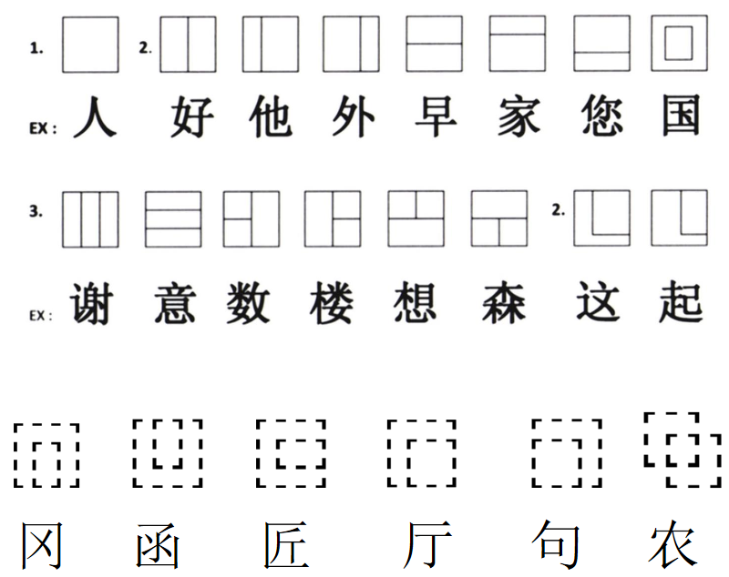
7. Character structures
When you practice writing kanji, you'd better put the concept of "balance" in your mind.

Slide 23
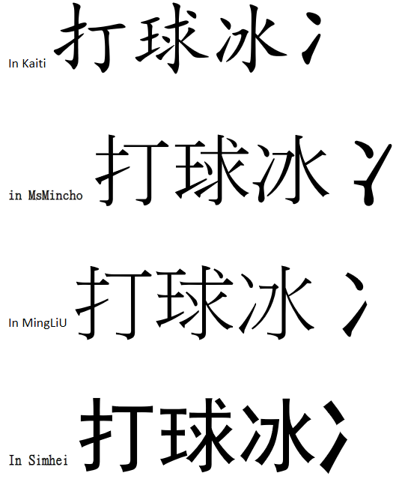
8. Different fonts
When you use different fonts in your computer, the same character will look different.

Slide 24
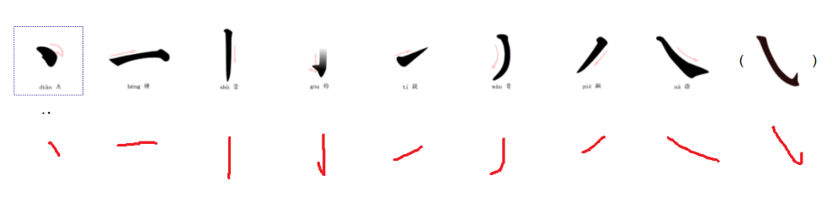
9. Different effects
When you use different pens to write the characters, the appearance will be different.

Slide 25
10. You just wonder how to write some kanji
a. Kanji lookup in JimBreen's WWWJDIC. Input the words or characters, and then click on the brush.
b. Denshi Jisho - online Japanese dictionary. Input the words or characters, and then click on the "Kanji details".

Slide 26
11. How to look up a kanji if you do not know the pronunciation
How to look up a kanji

Slide 27
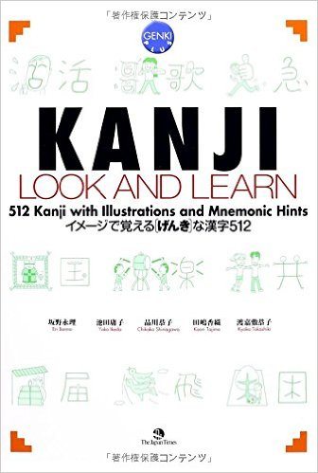
12. Kanji Look and Learn
https://www.amazon.com/Kanji-Look-Learn-Eri-Banno/dp/4789013499?ie=UTF8&*Version*=1&*entries*=0

Slide 28
12. Kanji Look and Learn
Let's learn kanji easily through fun illustrations! Including all kanji in level 3 and 4 of the Japanese Language Proficiency Test [Book Features]
-Kanji can be easily learned through fun illustrations and mnemonic hints.
-Users can readily look up the meaning, readings, stroke count, and stroke order of kanji.
-Various indexes at the end of the book to allow learners to easily look up a particular kanji or kanji vocabulary.
-The book contains 512 kanji, as well as 3,500 essential vocabulary(using those kanj) for beginner and intermediate learners. -The book includes all kanji in levels 3 and 4 of the Japanese Language Proficiency Text.
-The book includes all 317 kanji in the "Genki" textbook -The companion workbook helps users to learn kanji not only at the level of characters and words, but also in the context of sentences and longer text.

Slide 29
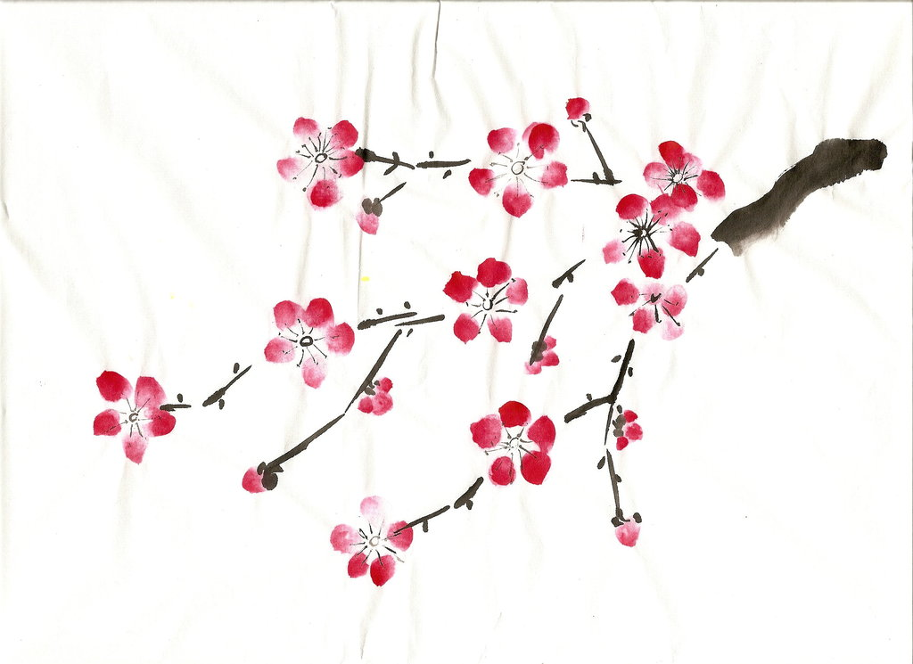
Thank you!
ありがとうございます。
Arigatou gozaimasu.

Slide 30
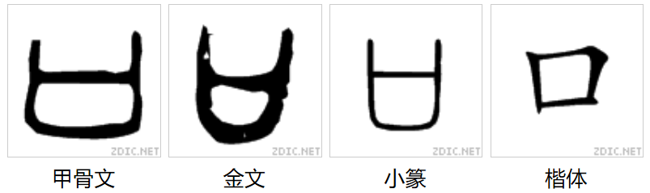
口 (くち) mouth
甲骨文 | Oracle Bone Script
篆书 | Seal Script
隶书 | Clerical Script
行书 | Semi-Cursive Script
草书 | Cursive Script
楷书 | Regular Script

Slide 31
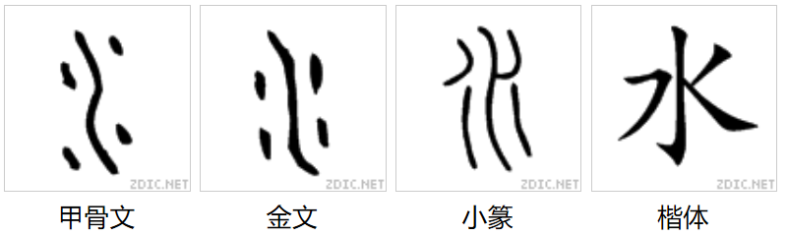
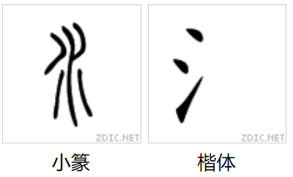
水/氵 (みず) water

Slide 32
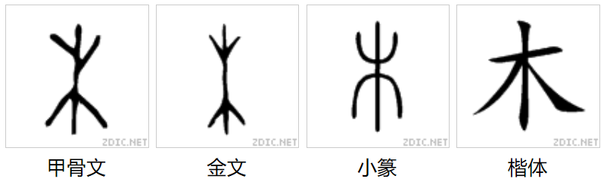
木 (き) tree

Slide 33
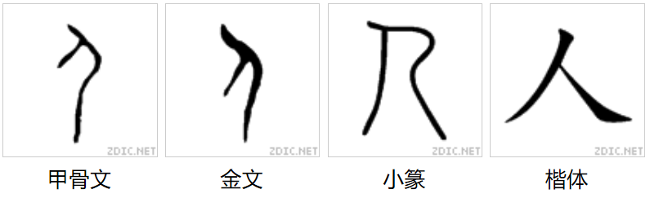
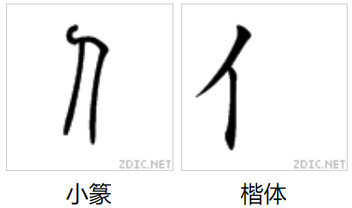
人/亻 (ひと) person

Slide 34
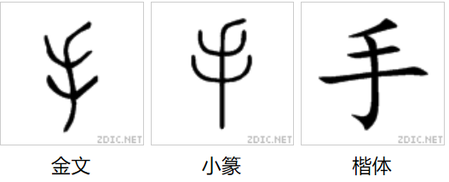
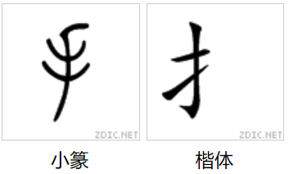
手/扌 (て) hand

Slide 35
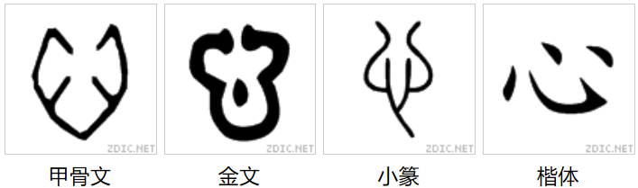
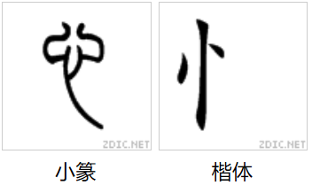
心/忄/⺗ (こころ) heart

Slide 36
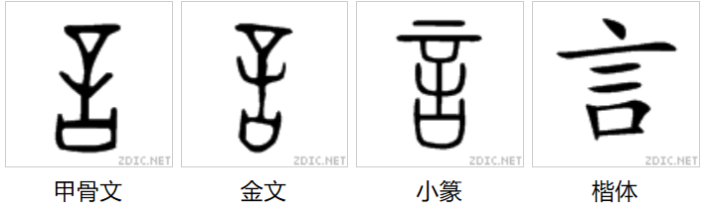
言 (こと) word
The shape of opening the mouth, sticking the tongue out, and trying to speak

Slide 37
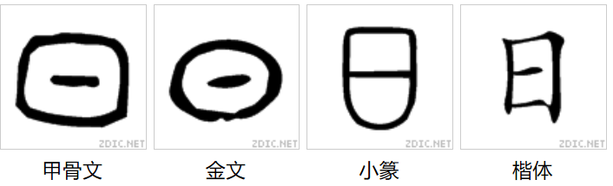
日 (ひ/にち) sun/day

Slide 38
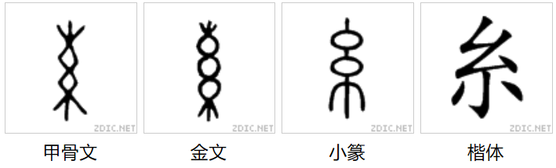
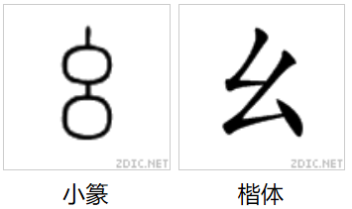
糸・幺 (いと) thread
The shape of a bunch of thread

Slide 39
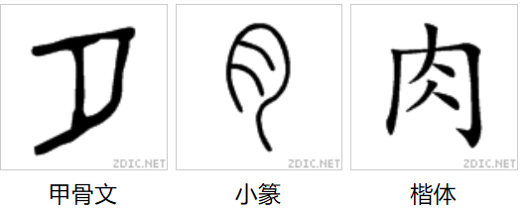
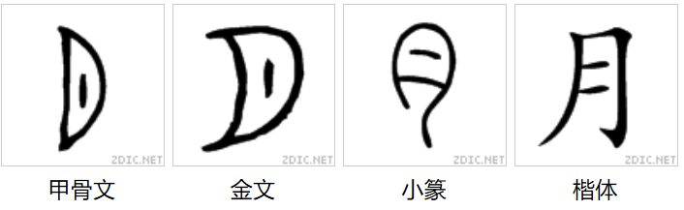
肉･月 (にく・つき) meat/organ (moon)

Slide 40
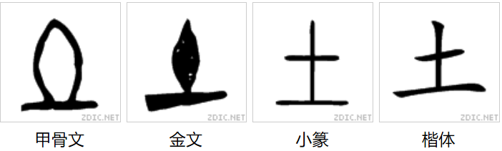
土 (つち) ground

Slide 41
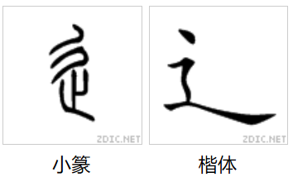
⻌ go/road radical
The shape of a person who is walking fast

Slide 42
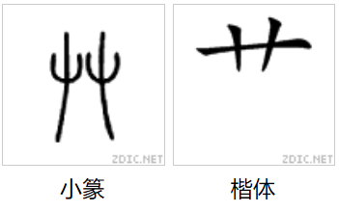
艹 grass/plant radical

Slide 43
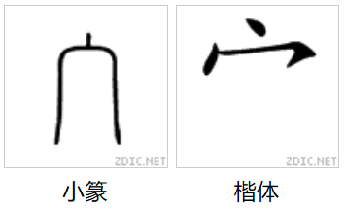
宀 roof/crown radical

Slide 44
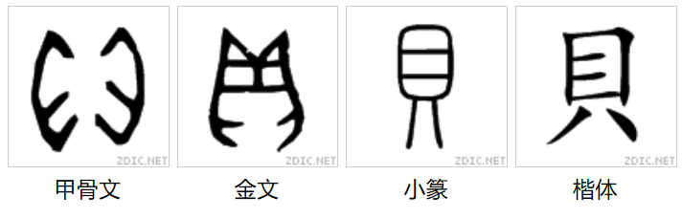
貝 (かい) shell

Slide 45
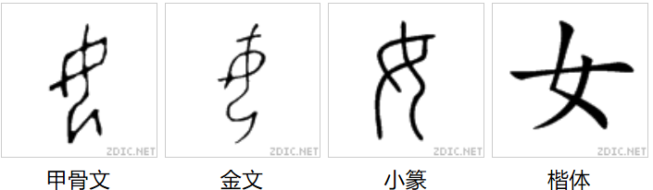
女 (おんな) woman

Slide 46
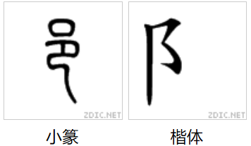
阝 village (right) wall (left) radical

Slide 47
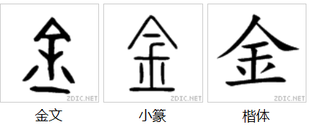
金 (きん) gold/metal
A compound ideogram character. Parts: 人 , 土, 二. 人(means covering from the top), 土(hidden under the ground); 二(the thing that was hidden under the ground).

Slide 48
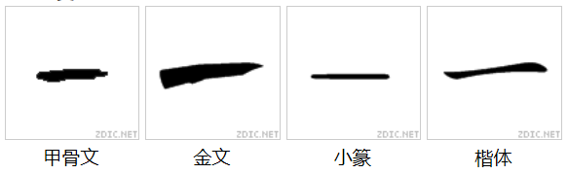
一 (いち) one

Slide 49
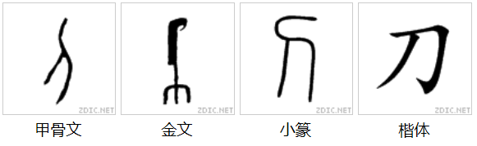
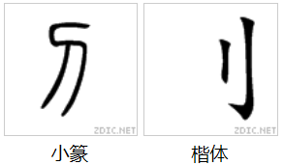
刀/刂 (かたな) sword

Slide 50
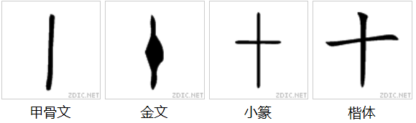
十 (じゅう) ten
In the old times, a stick, a tied knot

Slide 51
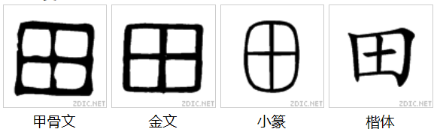
田 (た) rice field

Slide 52
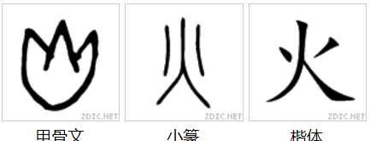
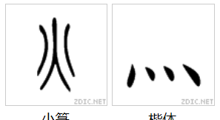
火/灬 (ひ/か) fire

Slide 53
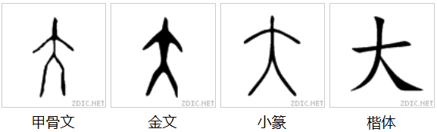
大 (おお) big
The shape of a person with his hands and legs open.

Slide 54

山 (やま) mountain

Slide 55

食 / 飠 (しょく) eat, food
A compound ideogram character, the bottom is a food container, the top is a lid or an opening mouth.

Slide 56

車 (くるま) vehicle

Slide 57

彳 walking person radical
step with left foot

Slide 58

目 (め) eye

Slide 59

雨 (あめ) rain

Slide 60


犬 / 犭 (いぬ) dog

Slide 61


玉（王） (たま・おう) king / ball (jewel)
玉, the shape of a rope with jade on it.
王, the shape of a large, axe-shaped weapon in ancient times, which represent power.

Slide 62

石 (いし) stone

Slide 63

力 (ちから) power
wooden handle of a plough

Slide 64

衣/衤 (ころも) garment

Slide 65

弓 (ゆみ) bow

Slide 66

竹・⺮ (たけ) bamboo

Slide 67

又 (また) again
The shape of the right hand

Slide 68


攵/夂 action radical
The shape of a hand holding a stick

Slide 69

示/礻 (しめす) show on an altar radical
The top is 上(up), the bottom is the sacrificial altar

Slide 70

酉 (とり) alcohol radical
a wine vessel

Slide 71

囗 (くにがまえ) enclosure radical

Slide 72

禾 grain radical

Slide 73

广 building on a cliff radical

Slide 74

疒 sickness radical
A person who is leaning on some bamboo sticks

Slide 75

巾 (きん/はば) cloth radical

Slide 76

尸 (し) corpse radical

Slide 77

寸 (すん) inch/sundial degree radical
Simple ideogram character, with a hand and one inch down from the wrist.

